Slide 1
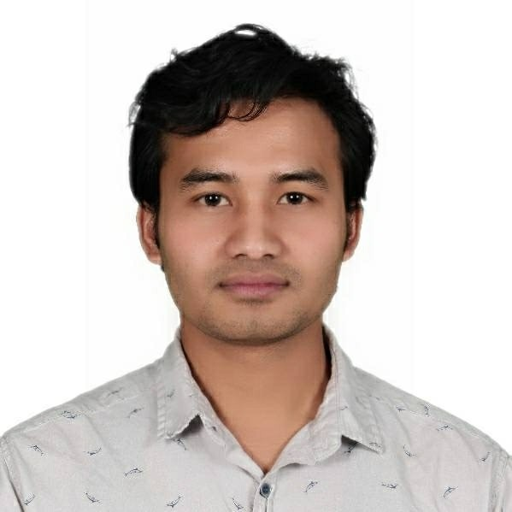
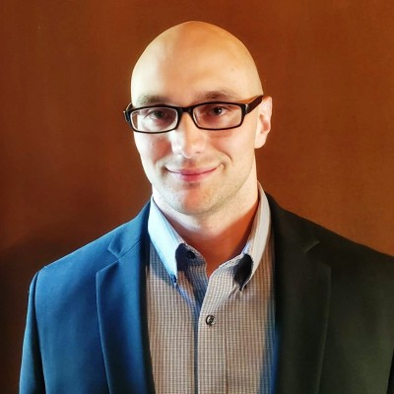



CAPSTONE PRESENTATION
Mental Health Problems in Orange County, California
Presented by: Sabindra Rai, MS-HDS
Mentor by : Mark Charipar , Project Manager and Data Scientist

Slide 2



Project Goal
Aim to make a live forecasting dashboard related to the quantity of mental health calls made to 2-1-1 OC and to help them to make more informed and intelligent decisions.

Slide 3
Introduction I
Organization: Plan4Co
Preceptor: Mark Charipar,
Project Manager
Data Scientist
About the Organization’s Structure: Plan4Co is a relatively new data science startup with less than 75 contractors. Plan4Co specializes solving data science problems and needs for small businesses for a competitive price, while offering a polished product and a “can do attitude”.
About the Project: The project involved a non-for-profit call center and forecasting the number of calls that are related to mental health.

Slide 4
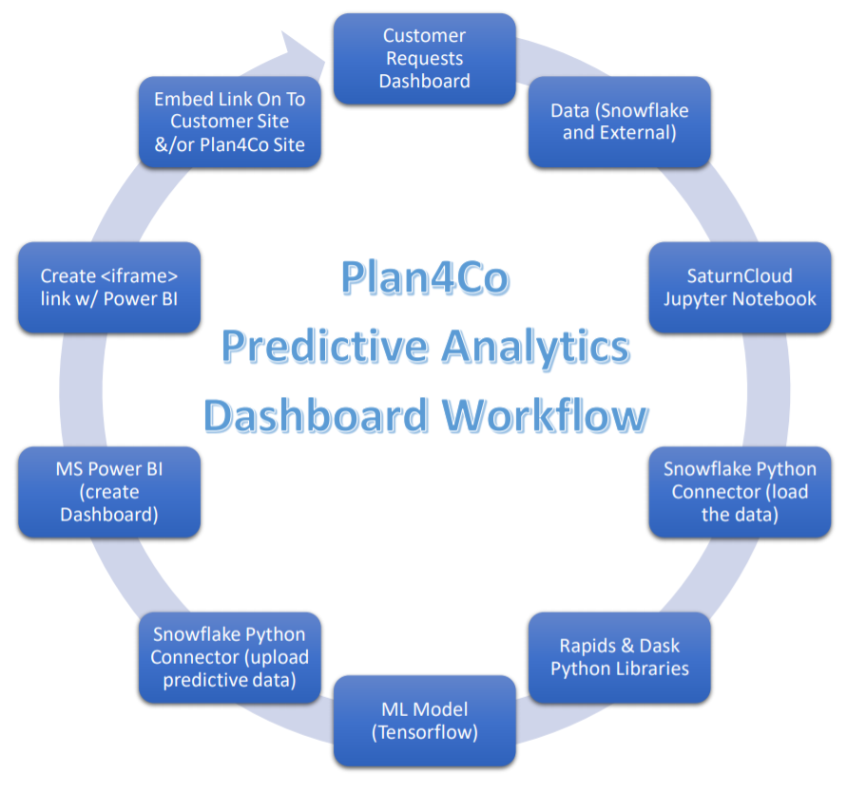
Introduction II
Takes a call centers CRM database data (iCarol) from excel files and uploads them to a cloud SQL database (Snowflake).
The call centers data is then transformed on the SQL database via Python and an API.
Then the data is loaded to a local machine and further transformed to be input into a ML model (LSTM).
The model forecasts the number of calls made to the call center that are related to mental health, as is defined by their taxonomy system.
The forecasted number of calls is uploaded to the SQL database in a new table.
Microsoft Power BI Pro is then connected to the SQL database using direct query mode and a visualization is created.
An embed public URL link is then created with Microsoft Power BI Pro and the URL was shared with the call centers IT personnel.
The call center then forwards monthly data from their CRM database
Upon receiving the updated data another python file is executed that updates the SQL database with the new data and predictions.

Slide 5
Introduction III
Literature
A world health Organization report in 2016 stated that about 15% of the older adult population suffers from mental issues.
In the Orange County MHSA program analysis, the current state of mental health is assessed.
The Mental Health Resource Guide provides the relevant directories to find the required information on a mental issue.

Slide 6
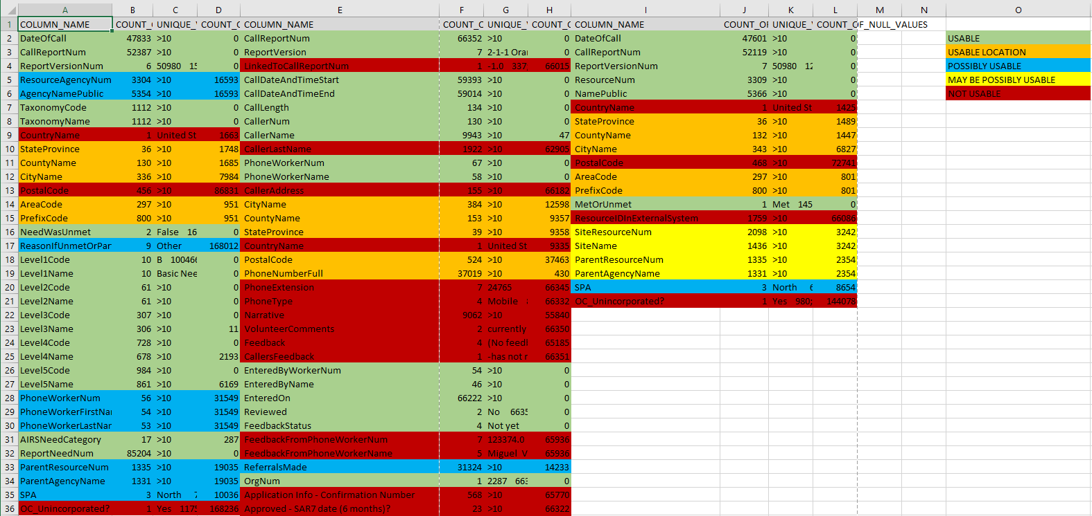
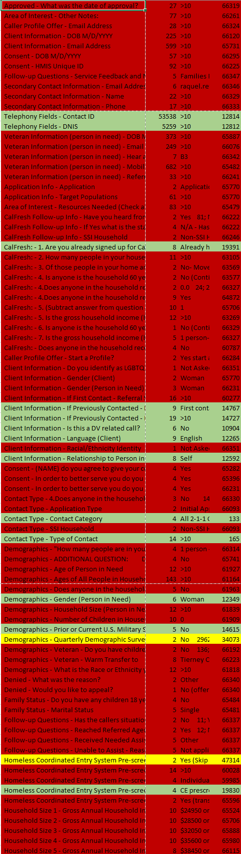
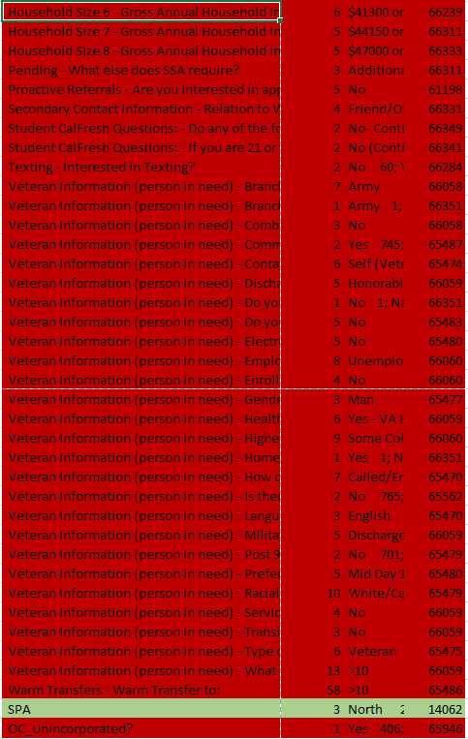
Methods
Dataset:
2-1-1 OC call centers datasets
Dataset from the year 2014 to 2021 (eight years' worth data)
Excel spreadsheets with three sheet
Transforming and Data Cleaning with SQL:
Transformed the datasets into the cloud platform Snowflake
Generated SQL queries for data cleaning in Snowflake
Shared the cleaned dataset with other Plan4Co member’s Snowflake account

Slide 7
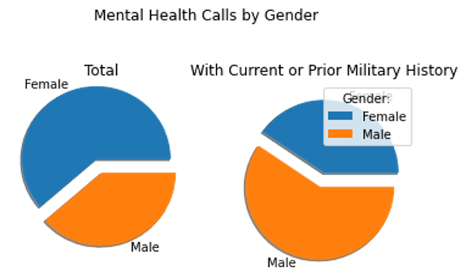
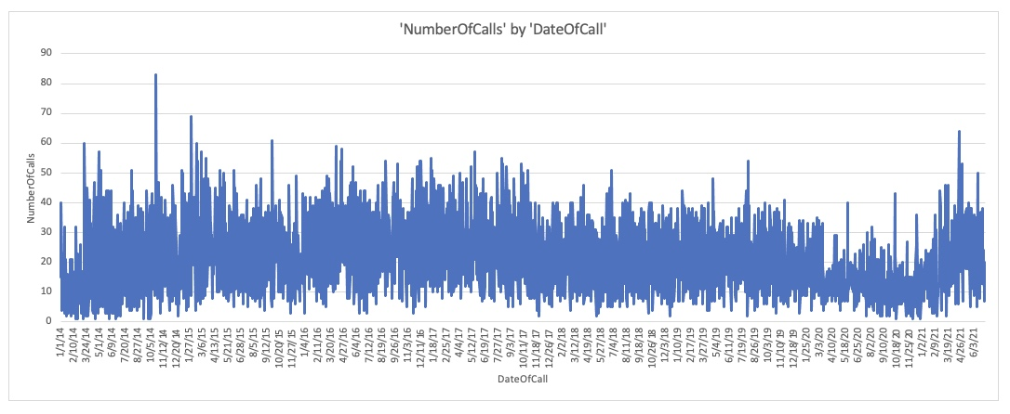
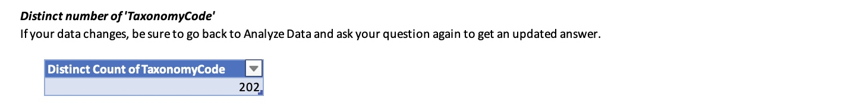
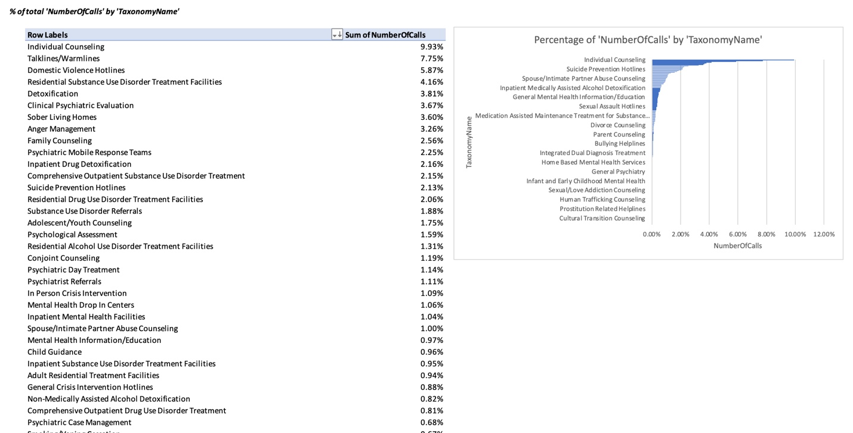
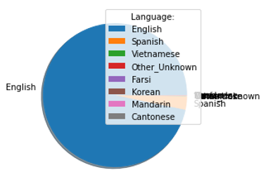
Methods
Exploratory Data Analysis:

Slide 8
Methods
Predictive model and forecast:
The call center was asking for a time series forecast.
Created an LSTM model of deep learning techniques
Minimum validation loss is 0.52 and minimum validation mae (mean absolute errors) is 0.51.
Allowed the customer to gain valued insight with the visualization from the model predictions
Used complex linear regression and compared numerous independent variables with dependent variables

Slide 9
Results
Next thirty days, total mental health calls will increase by just over one percent (1.38%).
Calls spiked during the Covid-19 Pandemic period.
Fewer number of calls were referred to related services.
Highest number of calls were received from females.

Slide 10
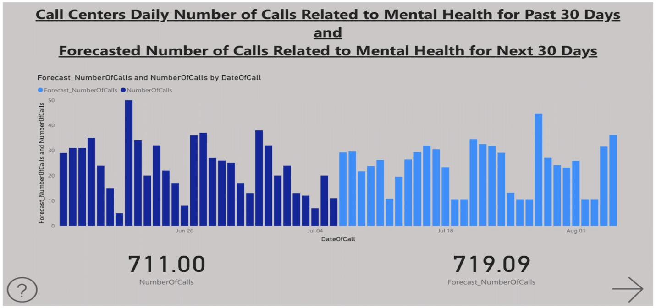
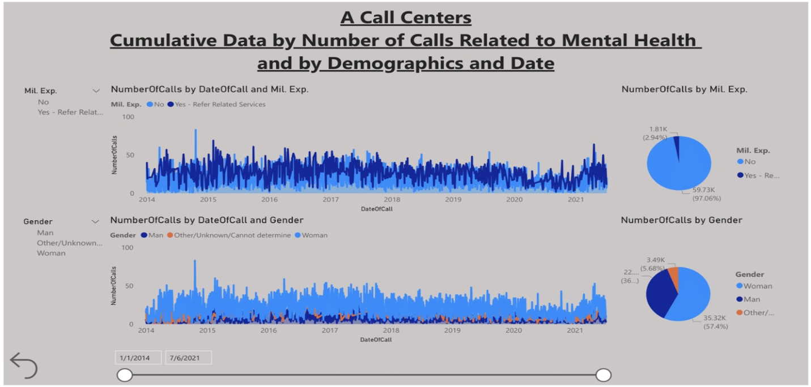
Dashboard

Slide 11
Recommendation & Lesson Learned
Recommendation:
Government should allocate more mental health facilities
Improve the standards of living
What have I learned from this capstone experience?
Solving real life problems
Ethical responsibility
Solving complicated problem in a easy way

Slide 12
Reference
https://www.tensorflow.org/tutorials/structured_data/time_series
https://www.211oc.org/images/2020/pdfcorona/2020_Older_Adult_Mental_Health_Resource_Guide.pdf
http://www.ochealthiertogether.org/content/sites/ochca/Local_Reports/Orange_County_MHSA_Program_Analysis_May_2018.pdf
https://www.ochealthinfo.com/sites/hca/files/import/data/files/116403.pdf
https://www.ocbc.org/wp-content/uploads/2020/09/2020-Community-Indicators-Report.pdf
https://www.unitedwayoc.org/wp-content/uploads/2018/07/orange-county-community-indicators-report-2018.pdf

Slide 13
Questions/Answers
Questions ?

